Slide 1
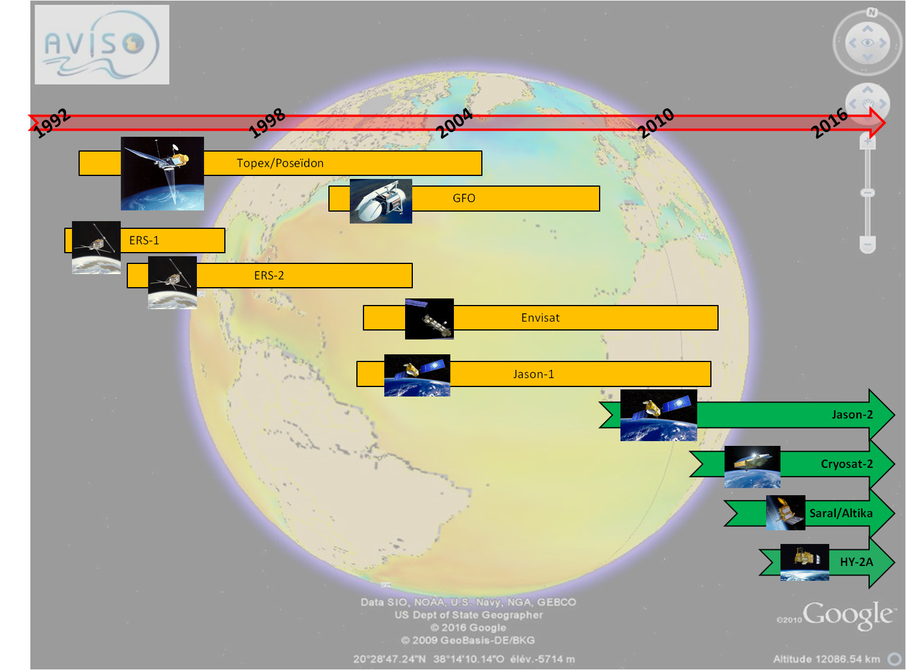
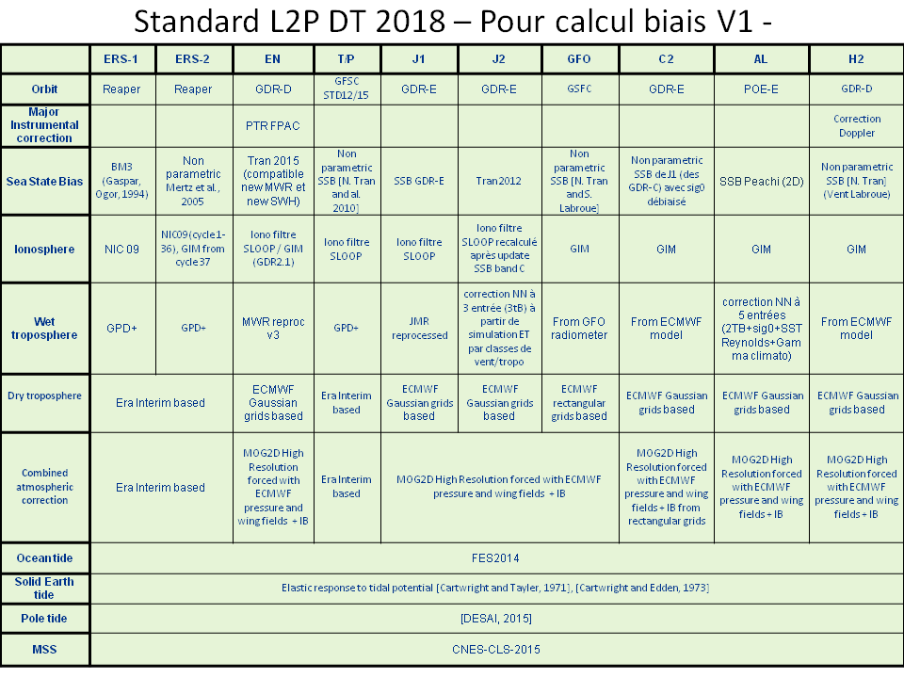
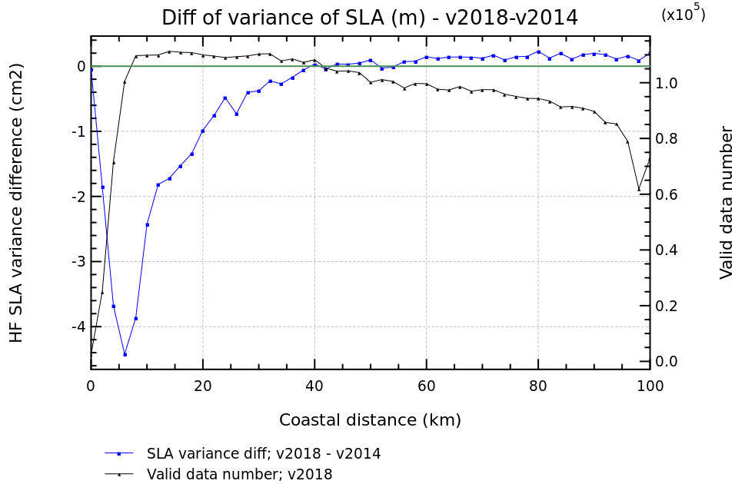
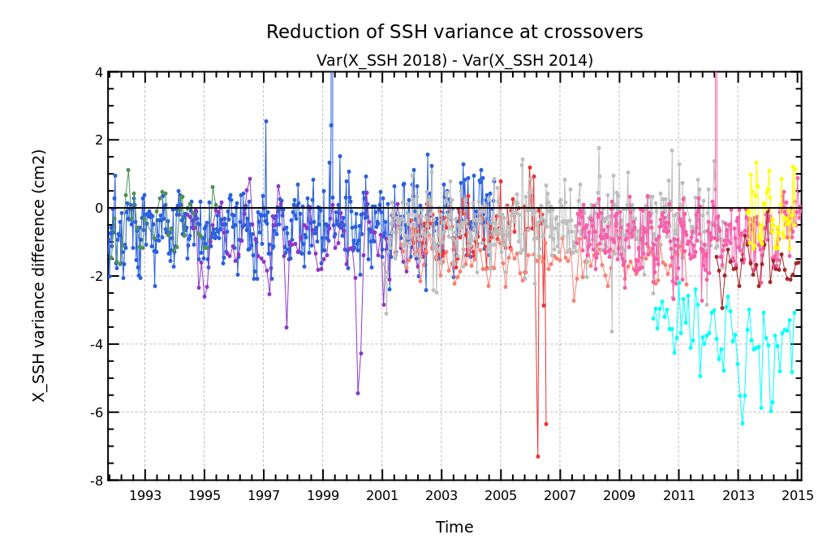
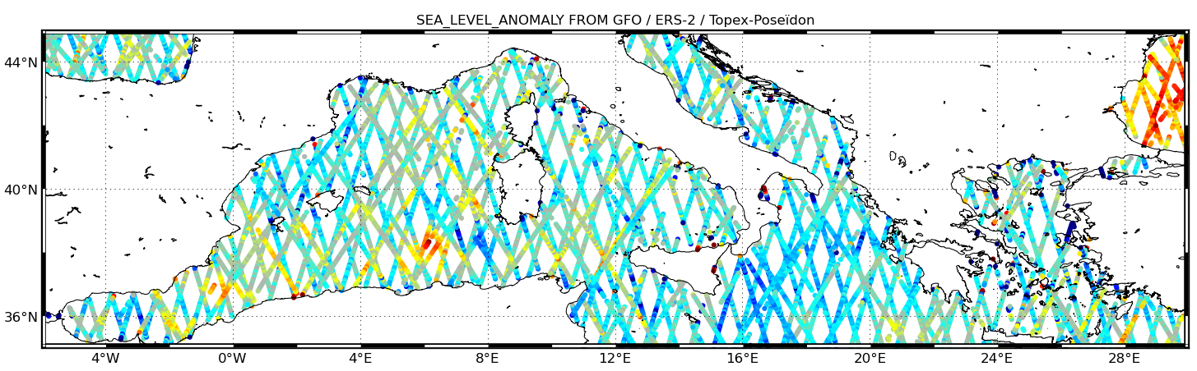
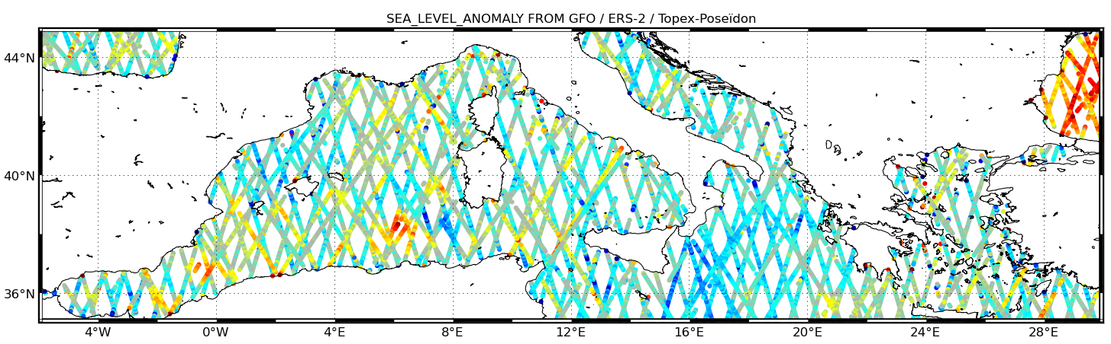
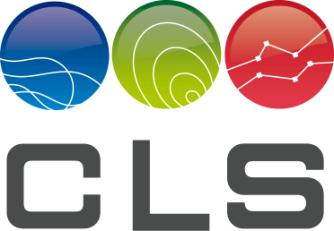
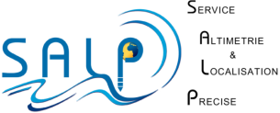
Getting ready for CMEMS 2018 reprocessing.
L2P database for
70 years of data and 10 missions
Use L2P data!!
via Aviso:
http://www.aviso.altimetry.fr/en/data/products/sea-surface-height-products/global/corssh.html
Via ODES: http://odes.altimetry.cnes.fr
M. Guibbaud¹, A.Ollivier¹ , Yannice Faugère¹, Jean-Damien Desjonqueres²
Contact: mguibbaud@cls.fr
1. CLS, Toulouse, France
2. CNES, Toulouse, France
L2P? What…?
10 missions used, 70 years of data
L2P is used to define high quality altimeter data, resulting from experts analysis;
L2P database contains a limited number of fields: the Sea Level Anomaly and its components, and an unique validity flag
2014
2018
L2P database is available for 10 missions (fig. 2) and contains an optimized estimation of Sea Level Anomaly on the whole altimetric period, representing 70 years of cumulated data…
L2P database is the input for CMEMS products reprocessing campaign (current version: 2014)
Here are presented the updates for 2018 campaign.
6 historic
missions
4 operationnal missions
2 new missions for CMEMS 2018 !!
Fig. 1
L2P database is a turnkey solution and is a reference for long term multimissions SLA analysis.
L2P database is dedicated to SLA product generation too, directly usable by a users, containing calibrated data on reference mission (example of multimission SLA on fig. 1)
Fig. 2
Altimetric standards - Multimission – CMEMS 2018
Altimetric standards for 2018 reprocessing
Large number of altimetric standards are updated for this new version of L2P database, including former missions too, fully described in fig. 3.
Multimissions updates:
Polar tide - Desai, 2015
Mean Sea Surface - CNES/CLS 2015; large improvement at high latitudes ; better resolution thanks to Crysoat drifting orbit additional information
Ocean tide – FES 2014; drastic improvement near coasts and high latitudes
Monomission updates:
Orbit: POE-E unless Envisat and H2; large scale and long term impact
Wet tropospheric correction: GPD+ for TP/ERS1/ERS2,Envisat (next reproc.) Jason-1 (reproc.), Altika and Jason-2 (updated 5 parameters solutions), …
New filtering solution for altimeter ionospheric correction, if available (SLOOP CNES project).
Fig. 3
New algorithms for ocean data selection
Comparison with CMEMS 2014 update -
global and regional improvement
Optimized filtering solution near coasts: spurious SLA values impacted by coasts are identified and removed (fig. 4)
Classical thresholds are enlarged : SWH, SLA
Reduction of variance of SSH at crossovers comparing 2014 and 2018 reprocessing versions, which indicates an improvement ot the asc./dsc. consistency, for all the missions (fig. 6).
Global increase of valid data number, near coasts, in high oceanic variability areas, in high waves areas; more consistent with the local sea state.
Great impact of some altimetric standards update (ocean tide), and from mss update (integration of Cryosat-2 information) (fig. 7)
Fig. 4
Standard deviation of range is considered as a function of SWH: valid SLA data consideration is refined in high oceanic variability areas.
Fig. 5
Optimization of ice data detection: combination of radiometer information with OSI SAF ice concentration information => more data detected as ice at high latitudes, more realistic
High SWH areas are better considered and valid dataset is extended
(fig. 5)
Fig. 7
Valid SLA from GFO, ERS-2 et Topex/Poseïdon (May 2000)
AL – Comparison with
2014 ice data discrimination
Fig. 6
Conclusion
A 10 missions homogenized database is now available for CMEMS reprocessing campaign; historical database (2014) is still maintained. Up to 2018, the two databases will regularly be updated with available GDR data to complete the series.
Great improvements due to updated altimetric standards are now effective. Combined with refined solutions for ocean data selection, consistency of Sea Level Anomaly will be clearly improved in global, for high latitudes and near coasts too.
Performances at crossovers are improved for all the missions and in global too. Even for old missions, great improvements can be obtained, which is encouraging to maintain and to update historical databases. This enable us to take better advantage of this important altimetric knowledge source.
L2P database will be used for 2018 CMEMS reprocessing campaign.
L2P current products is available on AVISO and ODES web sites (2014 update).
L2P reprocessed products will be available in 2018...
Reference:
M. Guibbaud, A. Ollivier, Y. Faugere, Jean-Damien Desjonqueres, Getting ready for CMEMS 2018 reprocessing ,in preparation
OST/ST meeting, Oct 31st- Nov 4th, 2016

