Slide 1
Ocean Surface Topography Science Team Meeting
Precise Orbit Determination Splinter
North-South miscentering of the Jason-3 orbit observed by its yaw-flip capability
Eléonore Saquet, Alexandre Couhert, Flavien Mercier

Slide 2
Introduction
OSTST 2020
Context
Previous approaches
Normal offset (GPS int ambiguity)
Flips approach (GPS int ambiguity)
Normal offset (other measurements)
Flips approach (other measurements)
Conclusion

Slide 3
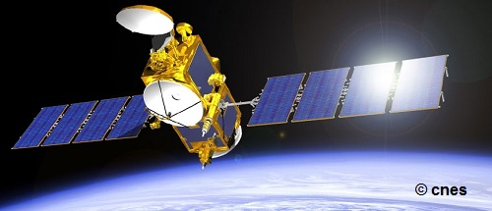
Context
OSTST 2020
Satellite: Jason-3
Nominal orientation: nadir Earth-pointed
Attitude law:
Yaw steering when β’>15° and β’<-15°
Fixed yaw when -15°<β’<15°
A yaw flip is performed at β’=0°
Yaw flip benefits:
Disentangle time tagging from along-track center of phase POD instrument offsets
Observe separately the combined effects of cross-track miscalibrated SRP models/thermal effects or POD instrument locations, and the Z-component of geocenter motion whose amplitude is thoroughly debated

Slide 4
Context
OSTST 2020
Goal:
Monitoring of the residual normal perturbations
Observation of the geocenter motion estimates in the Z (North-South) direction
Comparison with previous methods
Approach:
Focus on orbit arcs where flip events occur
Definition of the 8-day orbit arcs: 4 days before and after the flip events
Estimated empirical parameters:
constant cross-track accelerations with 4-day intervals
periodic once-per-revolution accelerations in the along/cross-track directions with 1-day intervals
constant along-track accelerations with 2 orbital period intervals

Slide 5
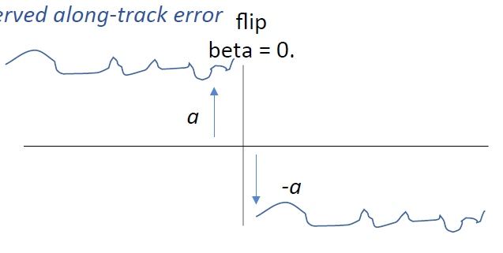
Context
OSTST 2020
Normal acceleration offset before and after the flip caused by:
Cross-track error in the POD center of phase location
Residual SRP modeling error of the satellite normal surfaces
Unmodeled satellite thermal effects
Common normal acceleration bias on both sides of the flip caused by:
Geocenter motion in the Z direction (mainly)
Residual solar-reflected/Earth-emitted radiation modeling errors?
The miscentering of the orbit around the Earth’s CM in the Z direction can be recovered using the equation:
$Tz=\frac{−C_{N0} r3}{GMcos(i)}$
where $C_{N0}$ is the common cross-track acceleration bias
Common normal acceleration bias
Normal acceleration offset

Slide 6
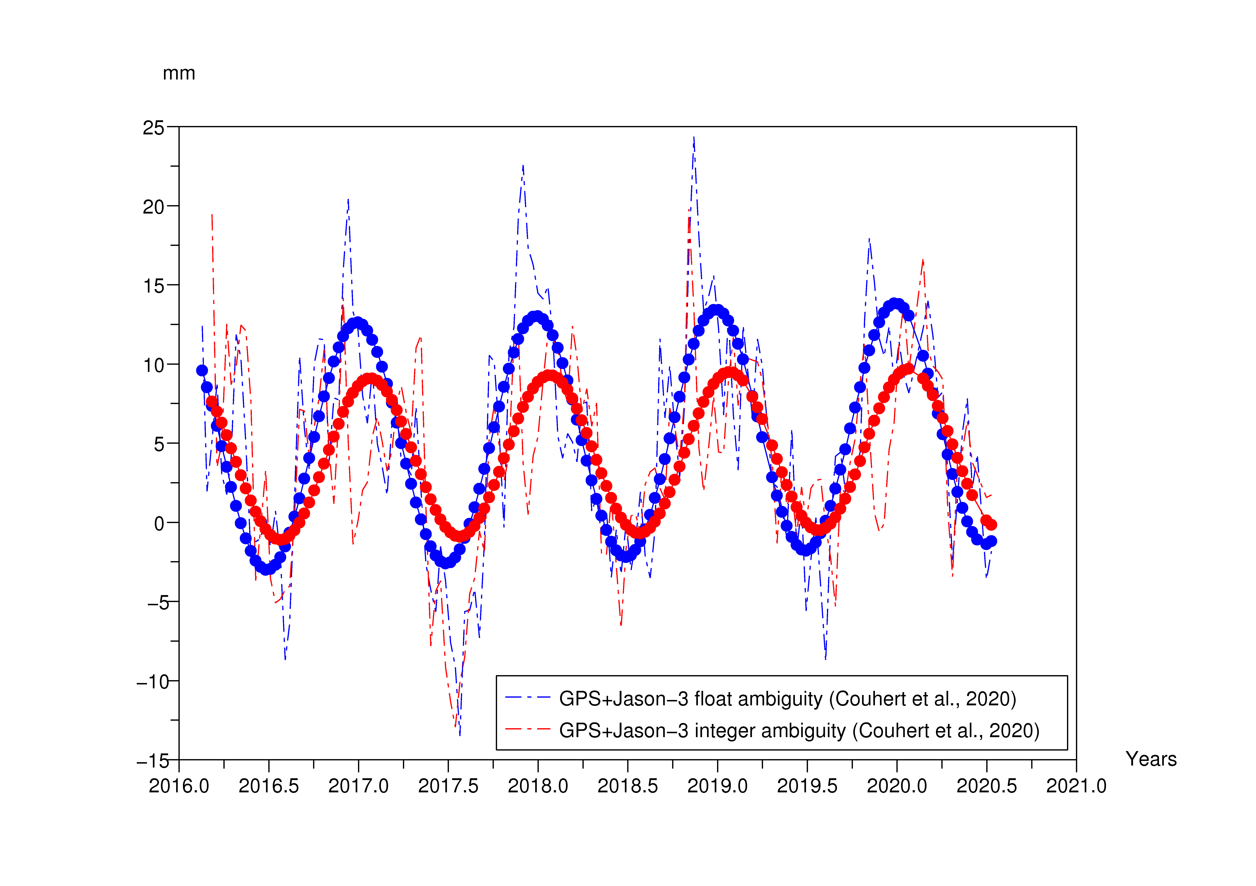
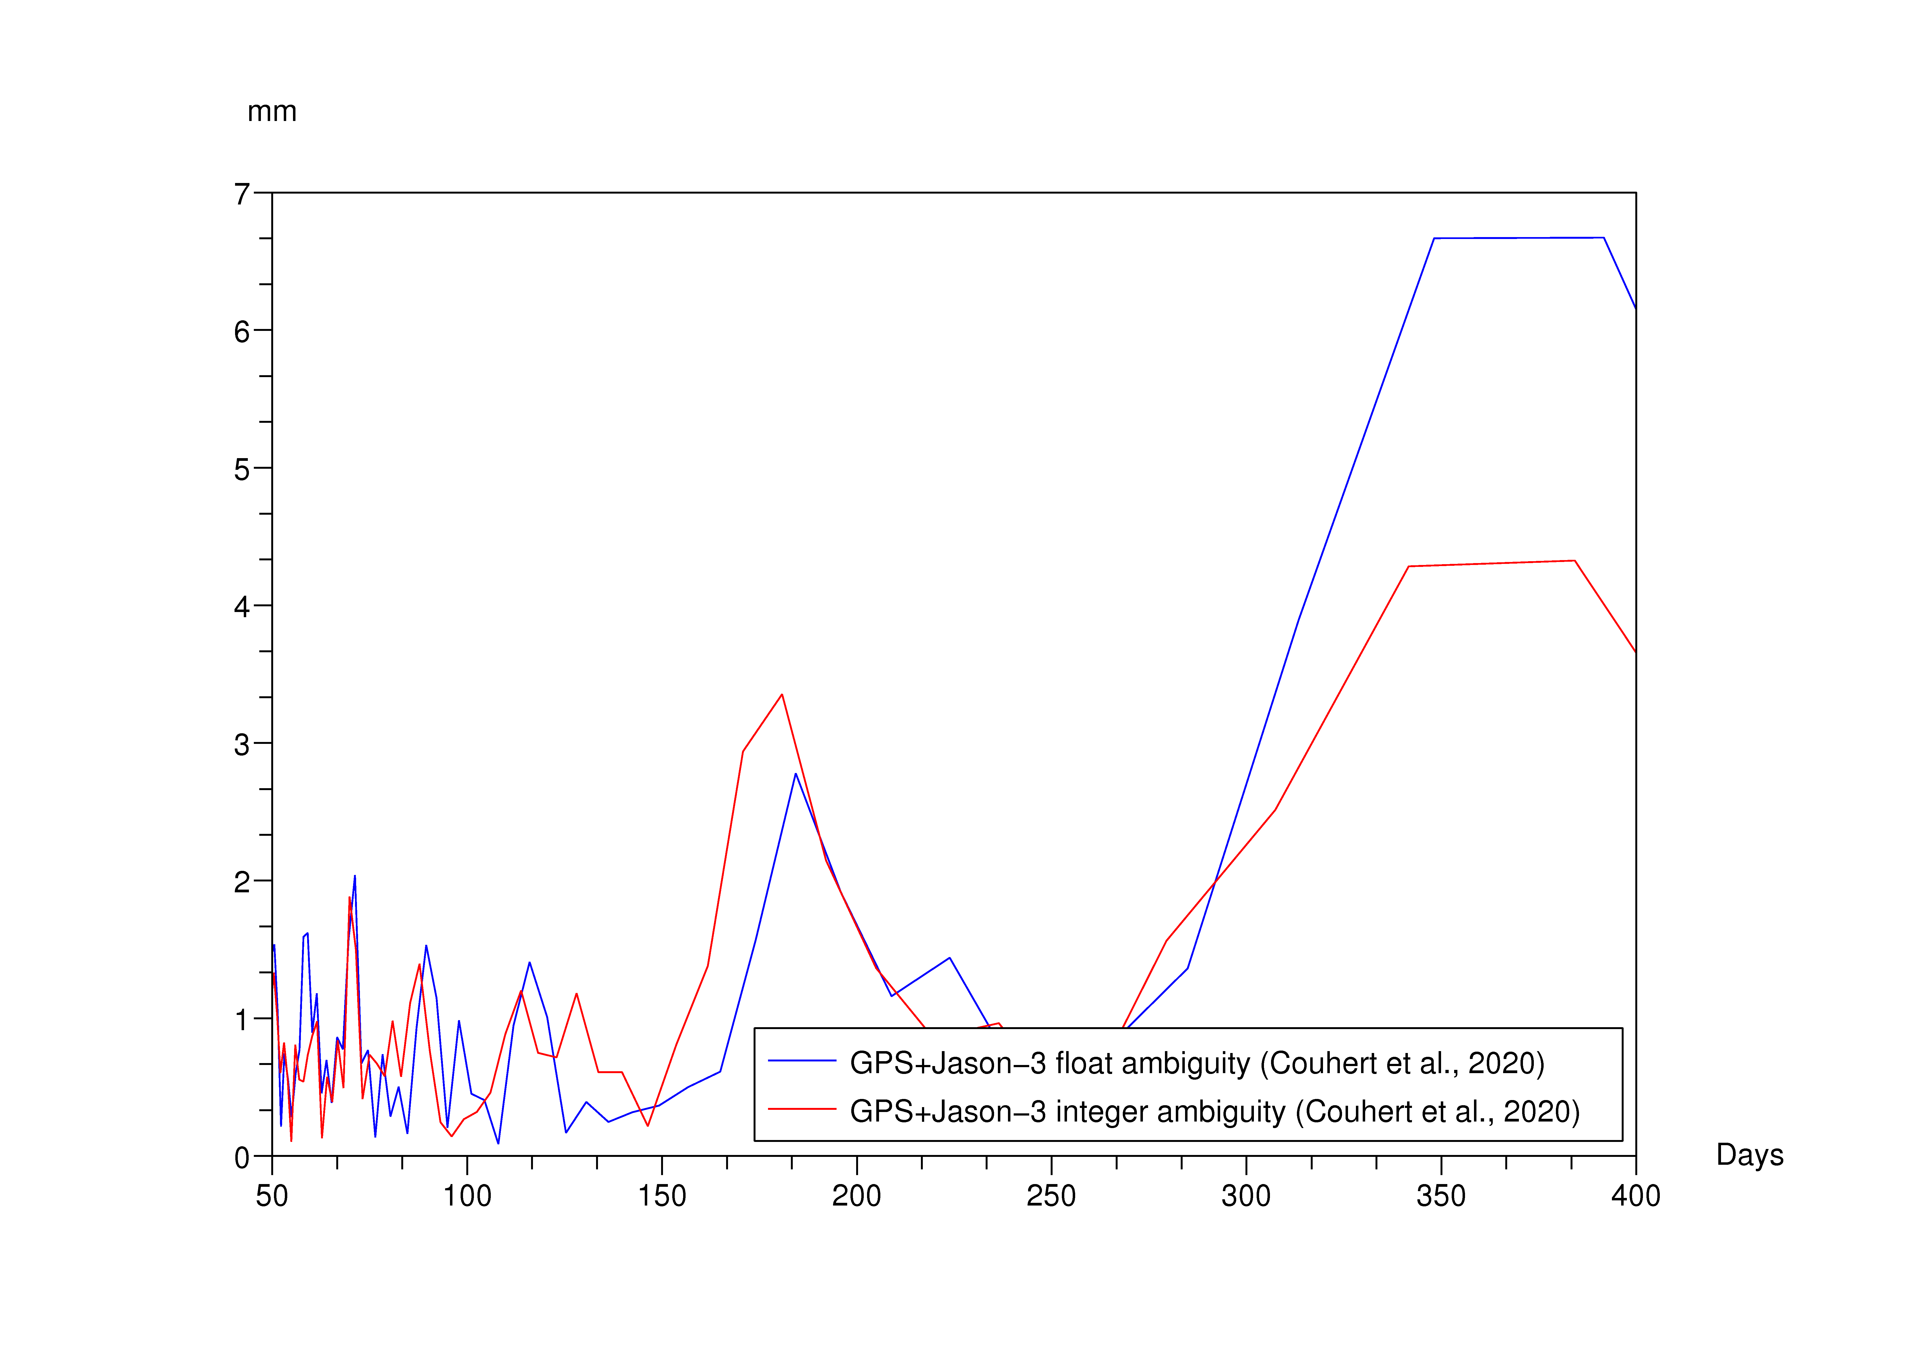
Previous approaches
OSTST 2020
Approach | 365-day Amplitude | Phase
GPS+J3 (flt. amb., Couhert et al., 2020) | 7.7 mm | 361 d
GPS+J3 (int. amb., Couhert et al., 2020) | 5.0 mm | 24 d
DORIS+J3 (Couhert et al., 2018) | 4.4 mm | 23 d
$$Tz$$
$$Tz$$

Slide 7
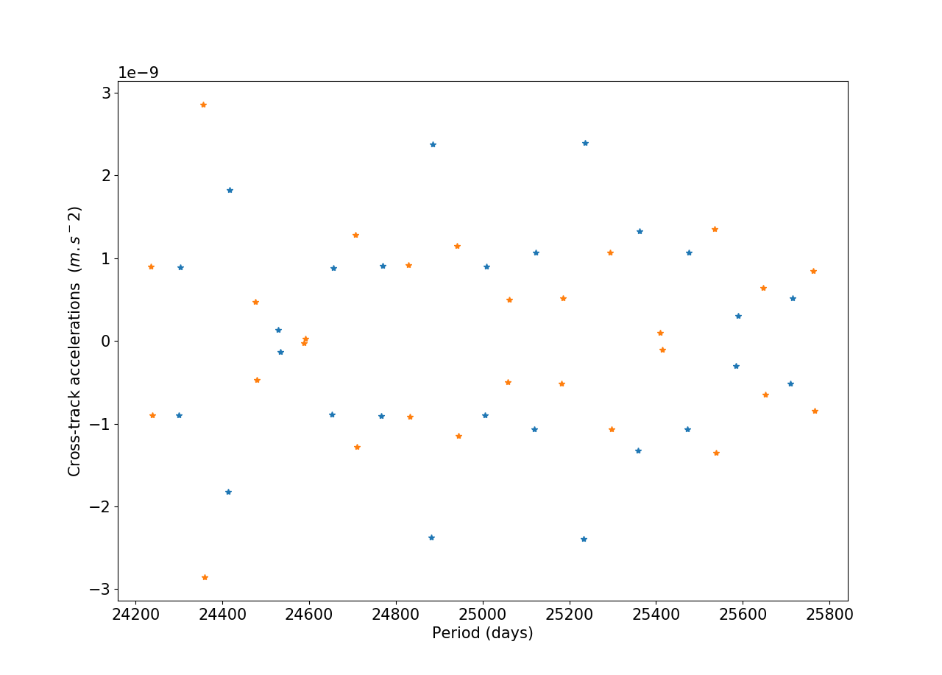
Normal offset (GPS int. ambiguity)
OSTST 2020
GPS measurements: integer ambiguity
Offsets of the estimated normal accelerations before/after the flip (the common bias has been removed), which can be attributed to a wrong cross-track center of phase/mass location. The correction to be applied is given by:
$$\frac{C_{N0}}{ω_{0}2}=1.15 mm$$
2$C_{N0}$
Nota: the two groups of colors (blue/orange) denote the forward and backward flying attitude regimes

Slide 8
Normal offset (GPS int. ambiguity)
OSTST 2020
$$Tz$$
Decrease in the 118-day signal of the previous approaches, when applying the normal offset correction (via the GPS antenna phase center)
Approach | 365-day Amplitude | Phase
GPS+Jason-3 (int. amb., Couhert et al., 2020) | 5.0 mm | 24 d
GPS+Jason-3 corr (int. amb., Couhert et al., 2020) | 5.0 mm | 24 d

Slide 9
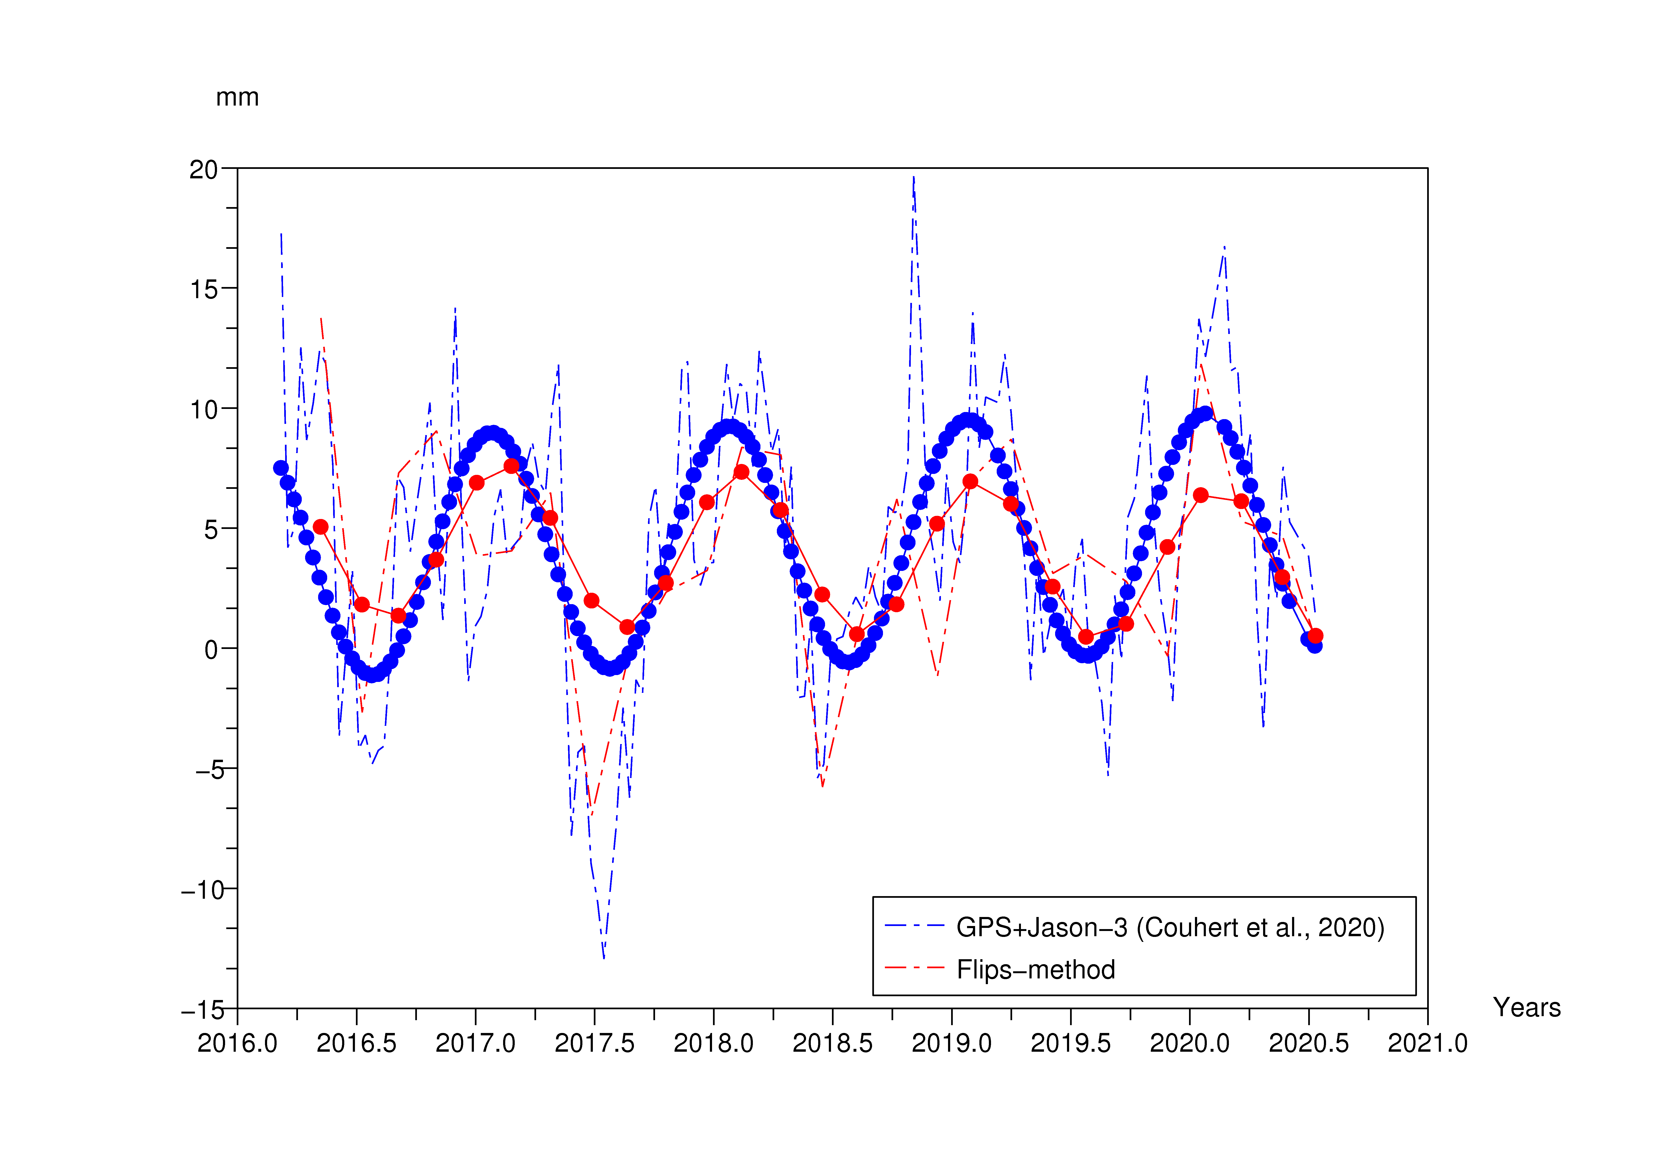
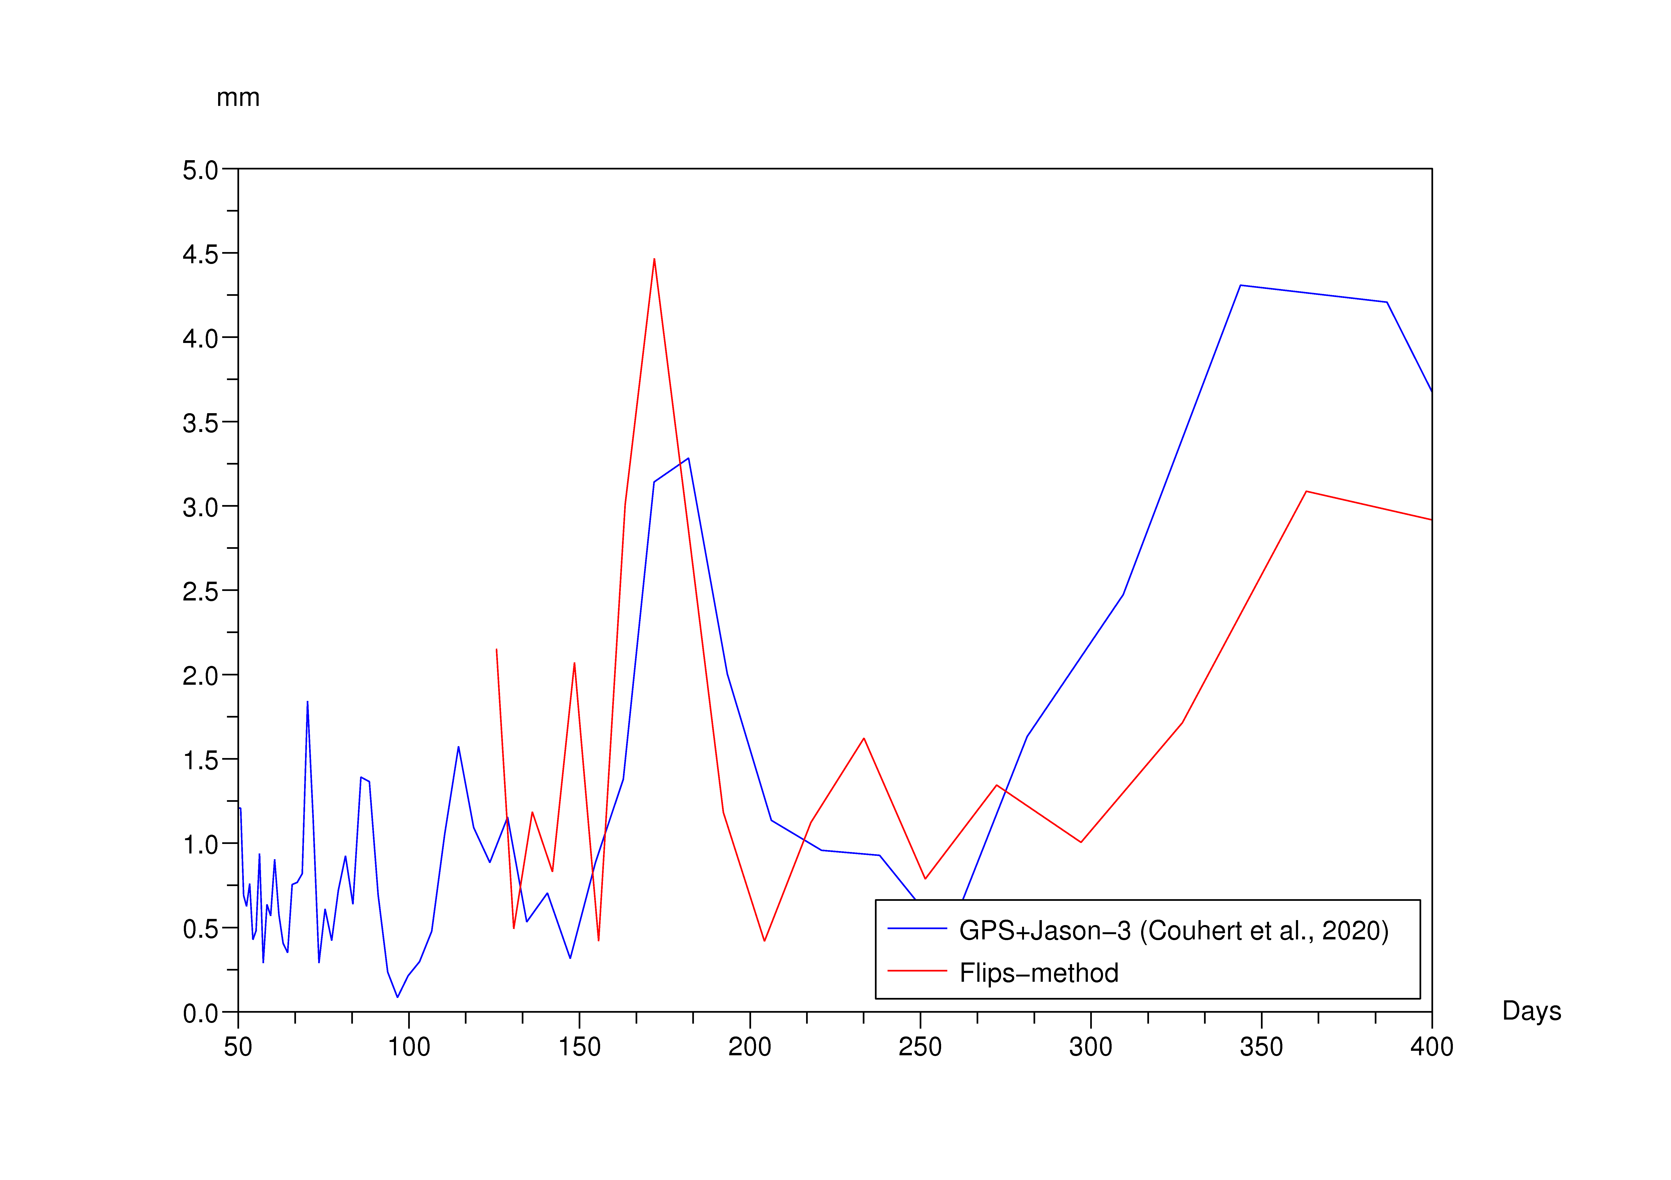
Flips approach (GPS int. ambiguity)
OSTST 2020
Common normal acceleration biases estimated on both sides of the flips reflecting the North-South miscentering of the Jason-3 orbit
Approach | 365-day Amplitude | Phase
GPS+Jason-3 (int. amb., Couhert et al., 2020) | 5.0 mm | 24 d
Flips (GPS int. amb.) | 2.9 mm | 48 d
$$Tz$$
$$Tz$$

Slide 10
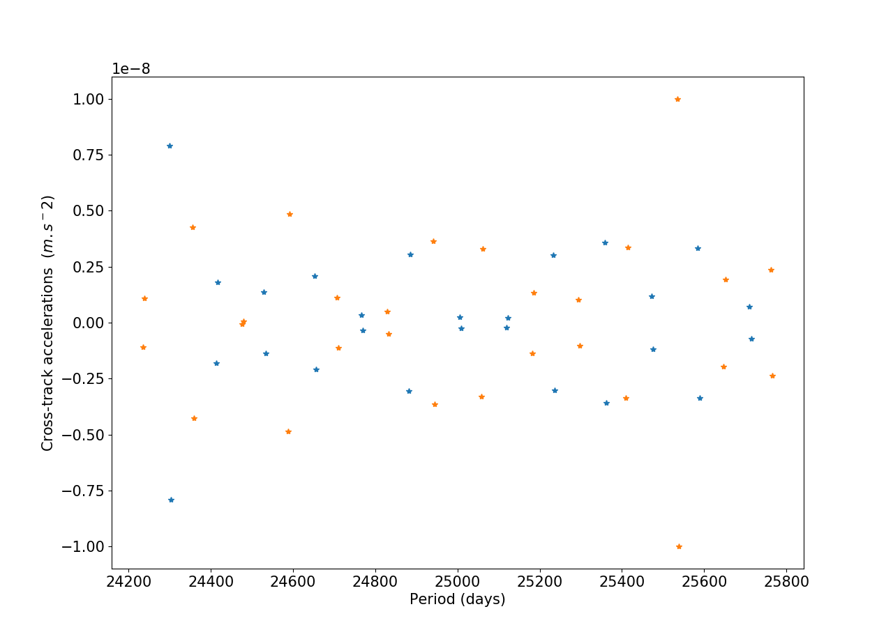
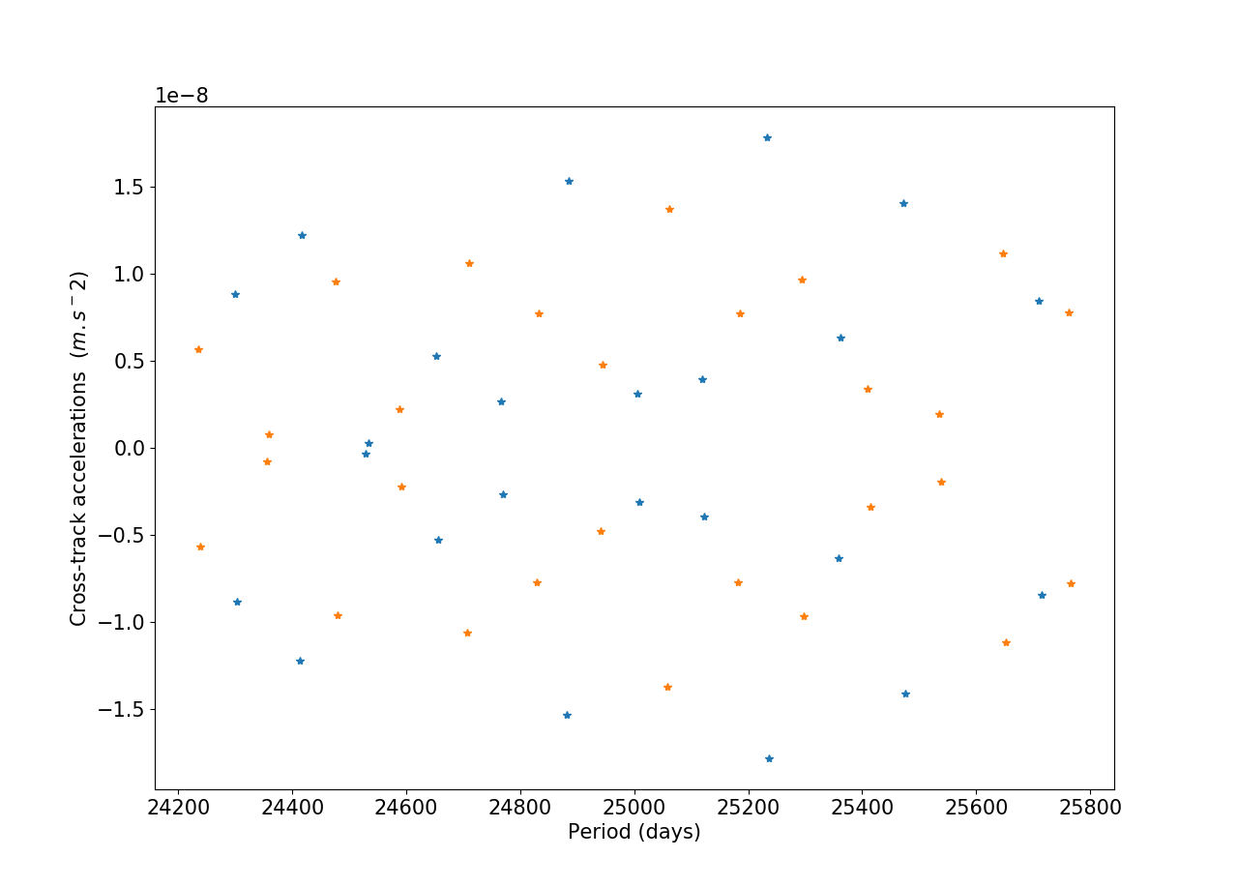
Normal offset (other measurements)
OSTST 2020
GPS measurements: float ambiguity
DORIS measurements
The observability of these measurements in the cross-track direction is not strong enough

Slide 11
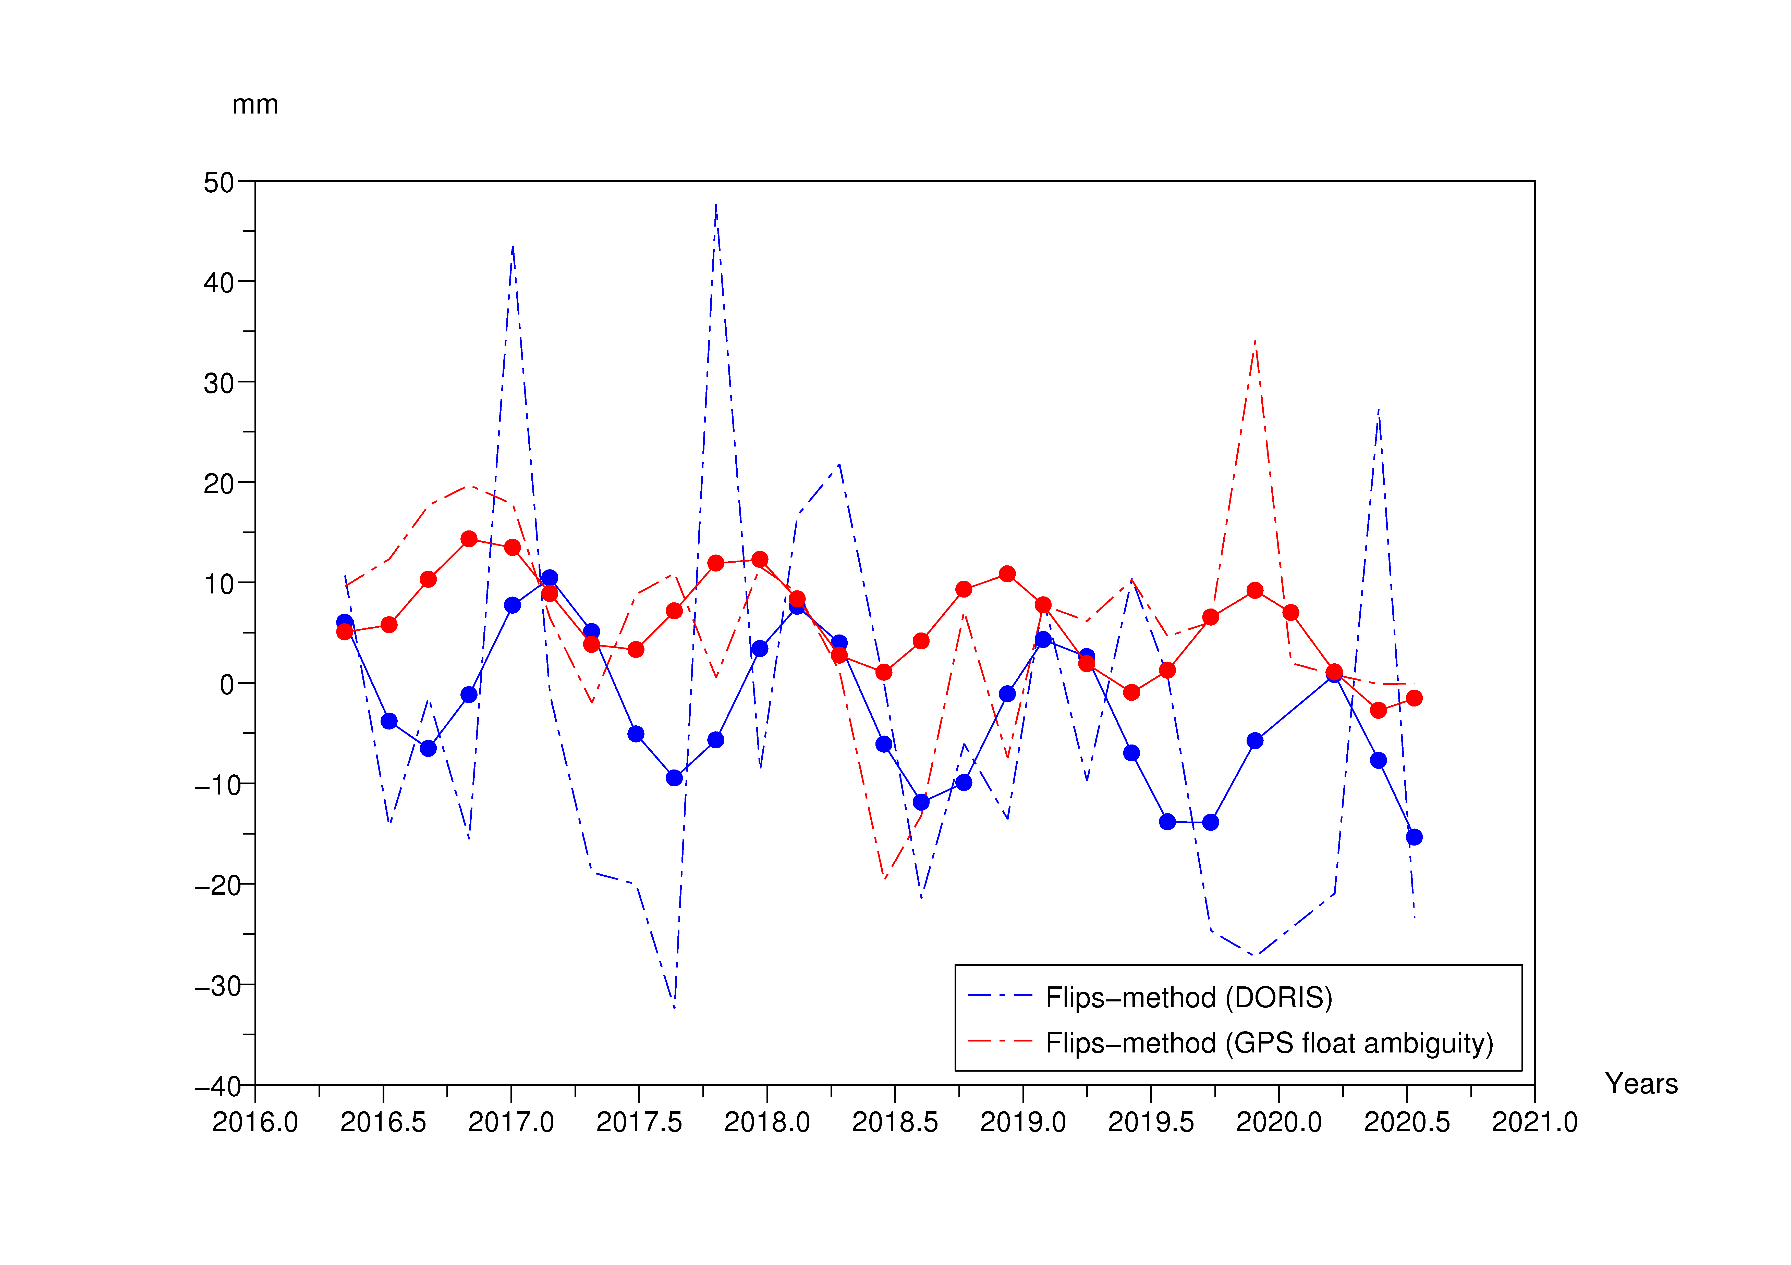
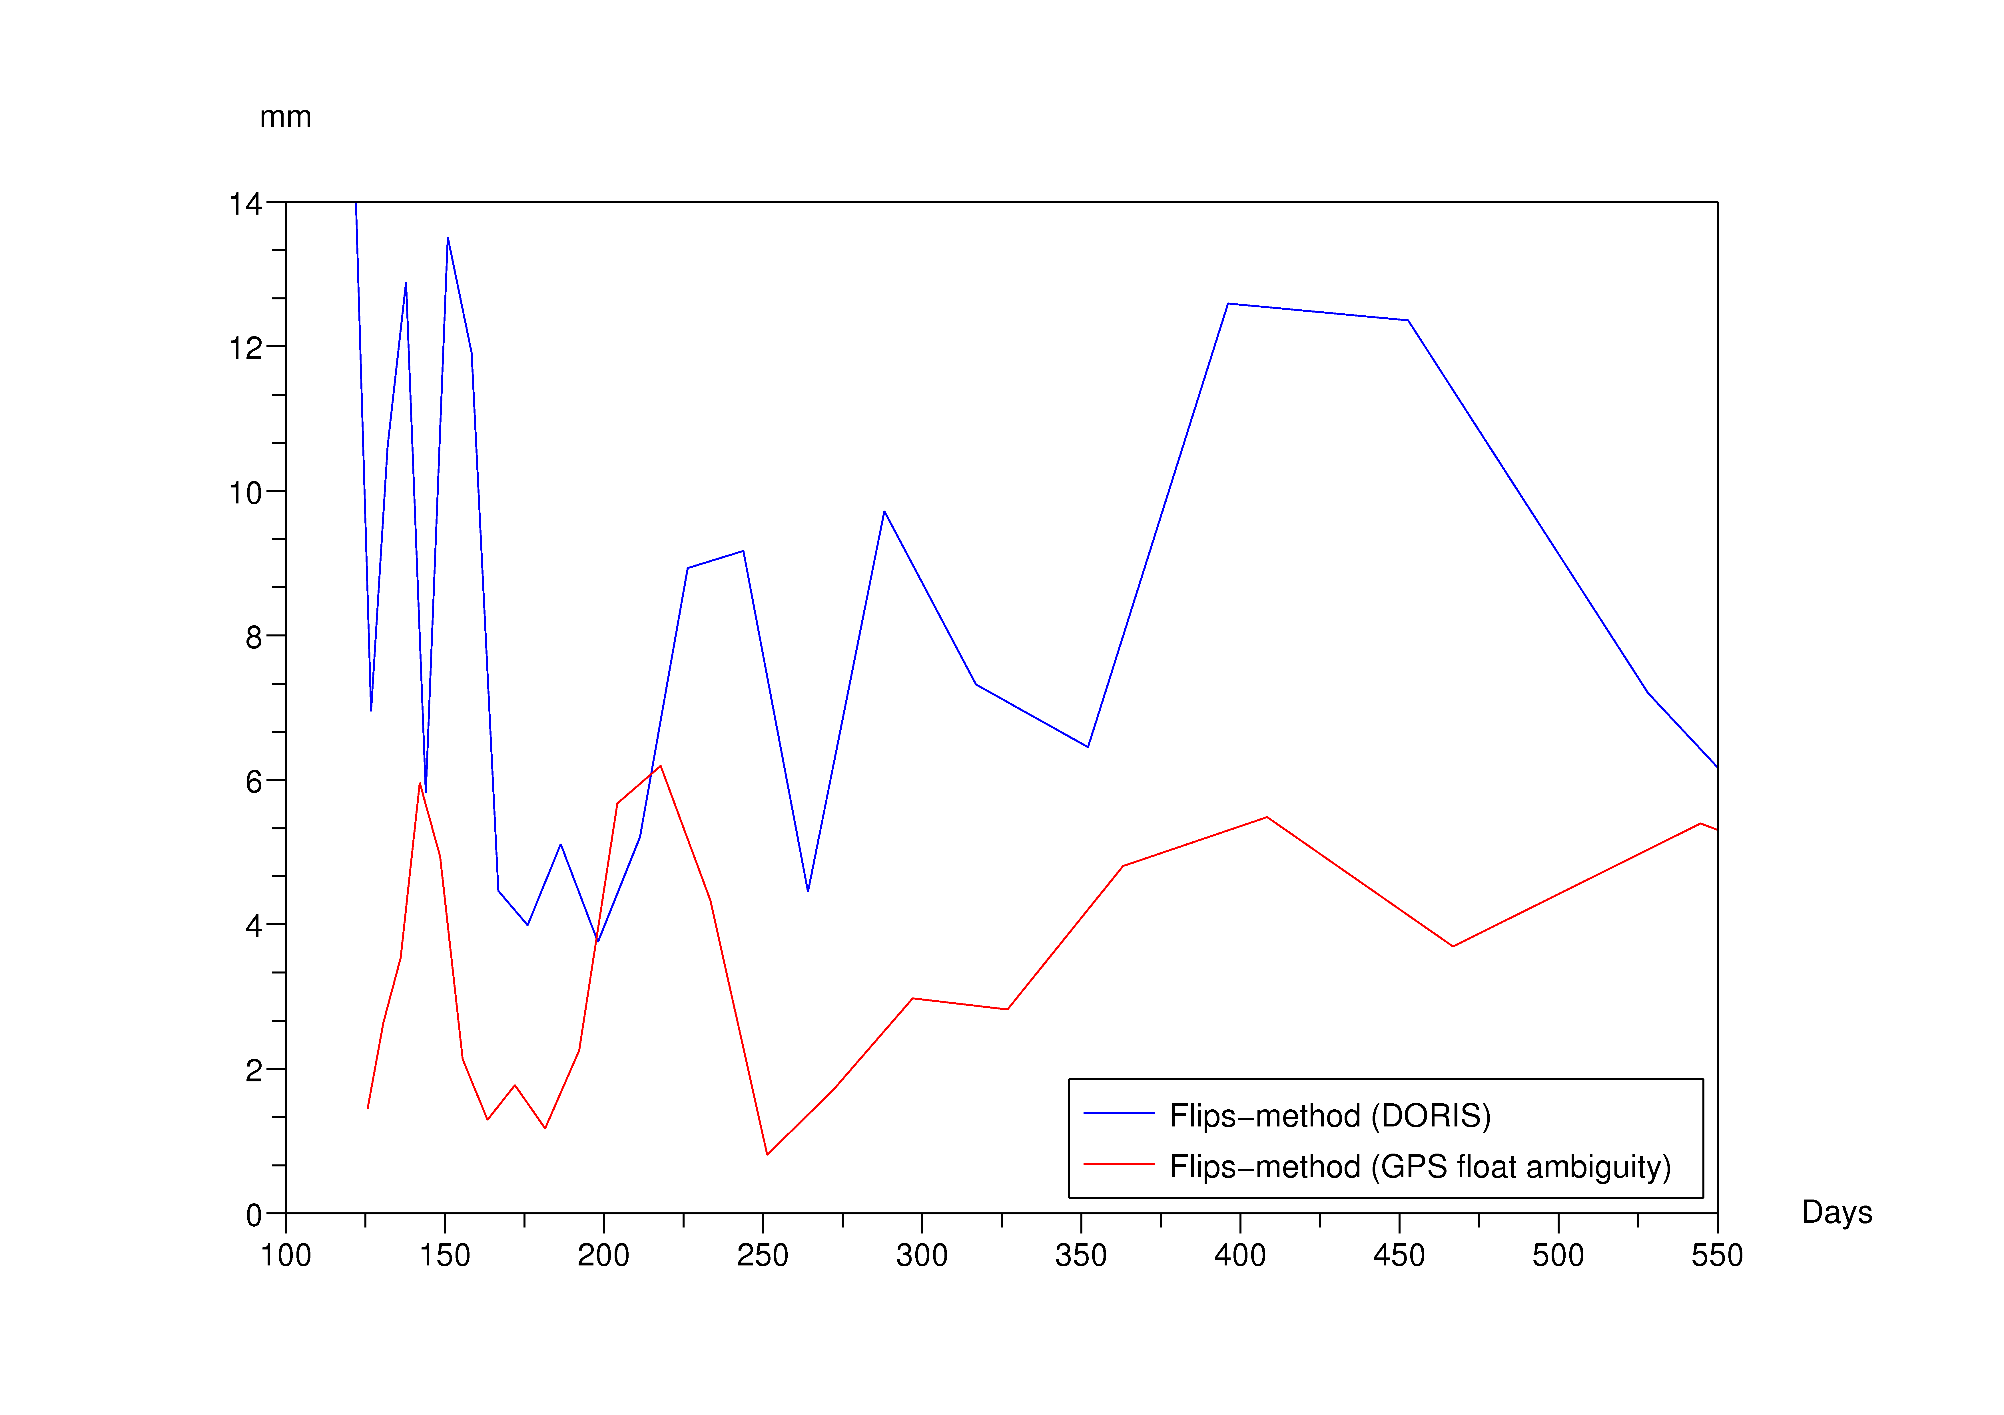
Flips approach (other measurements)
OSTST 2020
Approach | 365-day Amplitude | Phase
Flips (DORIS) | 9.3 mm | 52 d
Flips (GPS flt. amb.) | 5.5 mm | 331 d
$$Tz$$
$$Tz$$

Slide 12
Conclusion
OSTST 2020
The flips approach allows us to observe specifically the geocenter motion along the Z (North-South) axis.
The 60-day sampling and/or residual errors in the modelling of solar-reflected/Earth-emitted radiations could explain the differences in the annual TZ geocenter estimates between the flips and previous approaches.
Yaw flips are specific to the T/P and Jason missions. A recommendation of the OSTST POD group is to maintain the yaw flips for the Sentinel-6/Jason-CS mission.

